Slide 1
Death injury data Project
by\ Tamer Mostafa Abo_zeid

Slide 2
This dataset is obtained from Kaggle website. It describes injury mortality in the United States beginning from 1999 to 2016. Data are based on informations from all resident death certificates filed in the 50 states and the District of Columbia. Circumstances of an injury death: intent of injury and mechanism of injury are included. Source: https://catalog.data.gov/dataset/nchs-injury-mortality-united-states

Slide 3
Year (1999 -2016)
Sex (Male, Female and both sexs)
Age group (years)('All Ages', '< 15', '15–24', '25–44', '45–64', '65–74', '75+‘)
Race( All races', 'Non-Hispanic white', 'Non-Hispanic black', 'Hispanic)
Injury mechanism( All Mechanisms', 'Cut/pierce', 'Drowning', 'Fall', 'Fire/hot object or substance', 'Firearm', 'Poisoning', 'Motor vehicle traffic', …..ETC)
Injury intent( All Intentions', 'Legal intervention/war', 'Unintentional', 'Suicide', 'Homicide', 'Undetermined)
Deaths
Population ( the population of each case)
Age Specific Rate ( Deaths/Population for each 100,000 of population)
And other statistics

Slide 4
We create the columns:
Total Population( the total population of all cases for each year)
Population Ratio percentage ((Population/Total Population)*100))
Total Deaths( the total deaths of all cases for each year )
Deaths Ratio percentage( (Deaths/Total Deaths)*100 )

Slide 5
The Data is showing that

Slide 6
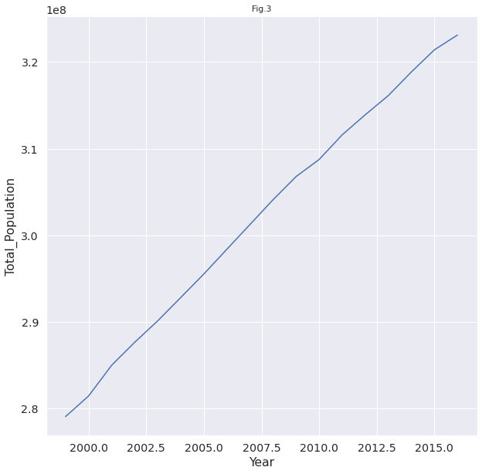
The increasing of total population with years

Slide 7
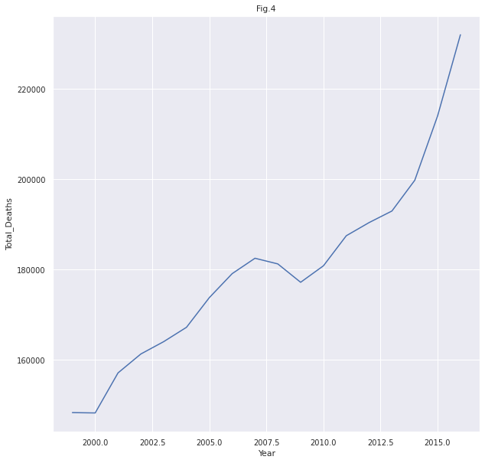
The total deaths with years

Slide 8
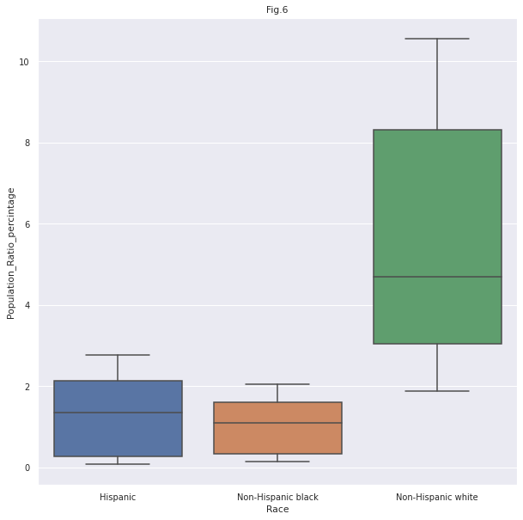
The race ratio

Slide 9
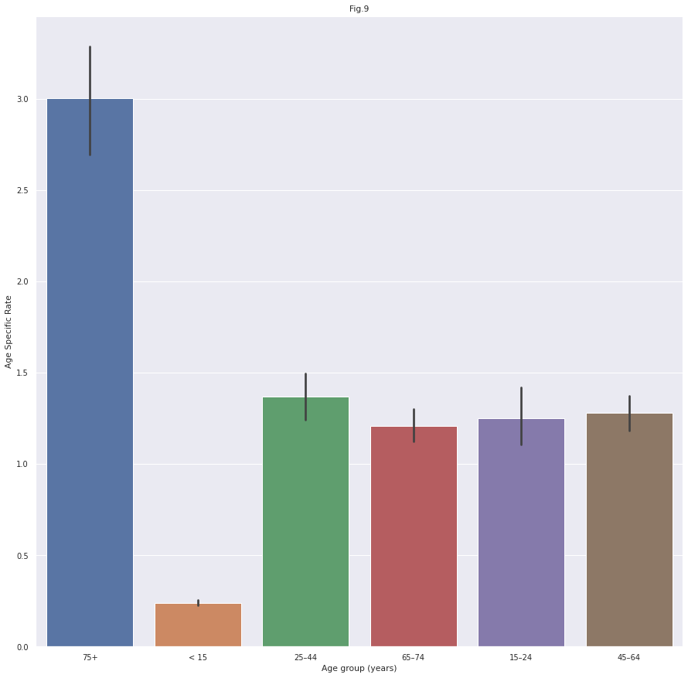
Death age specific rate for each age group

Slide 10
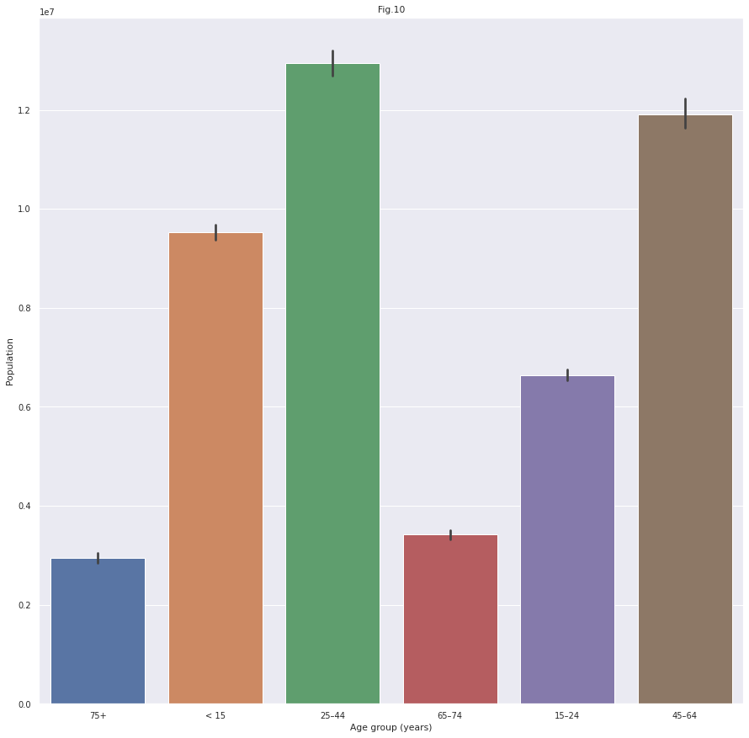
The population of each age group

Slide 11
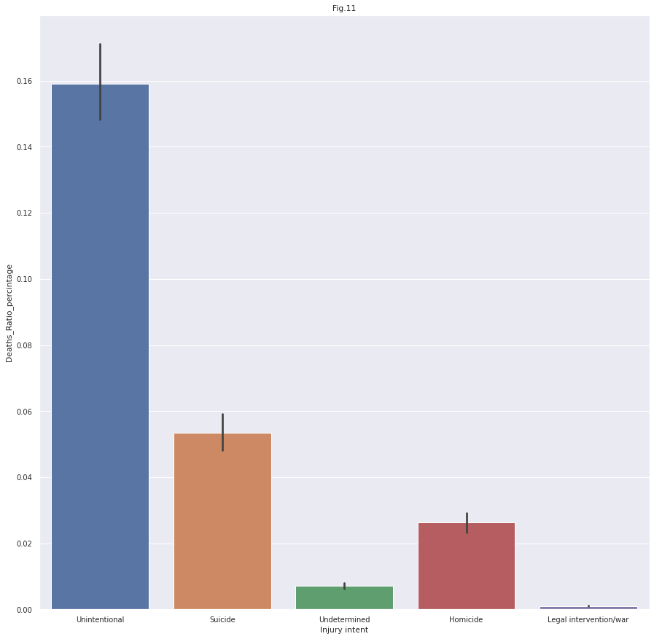
The death ratio percentage for each death intent

Slide 12
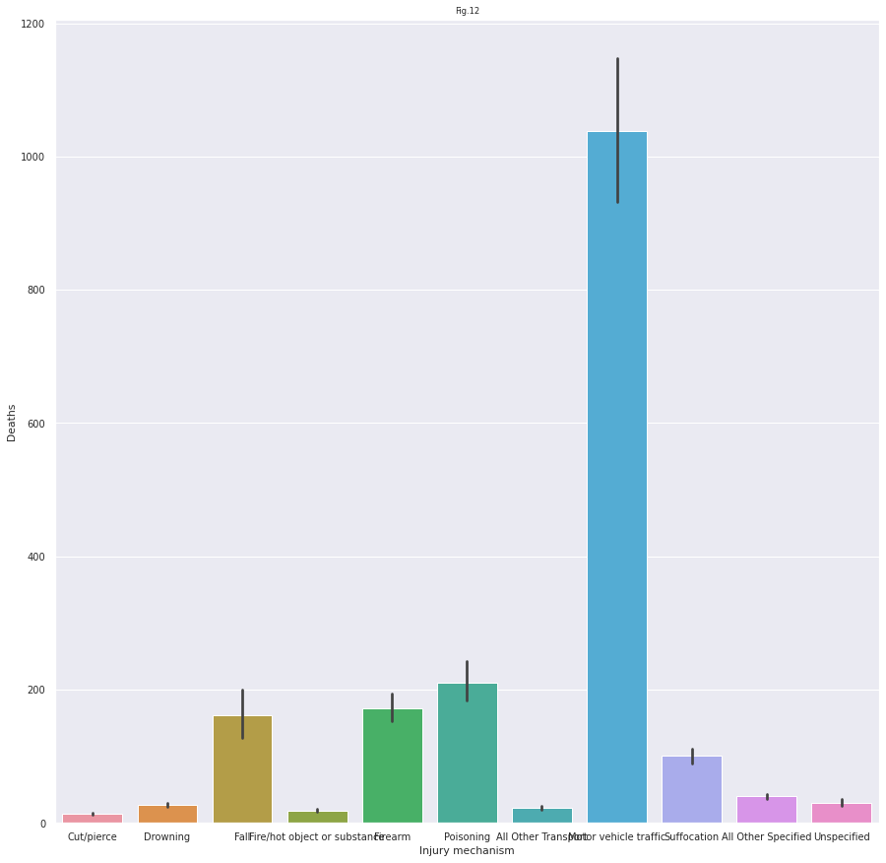
Death mechanisms

Slide 13
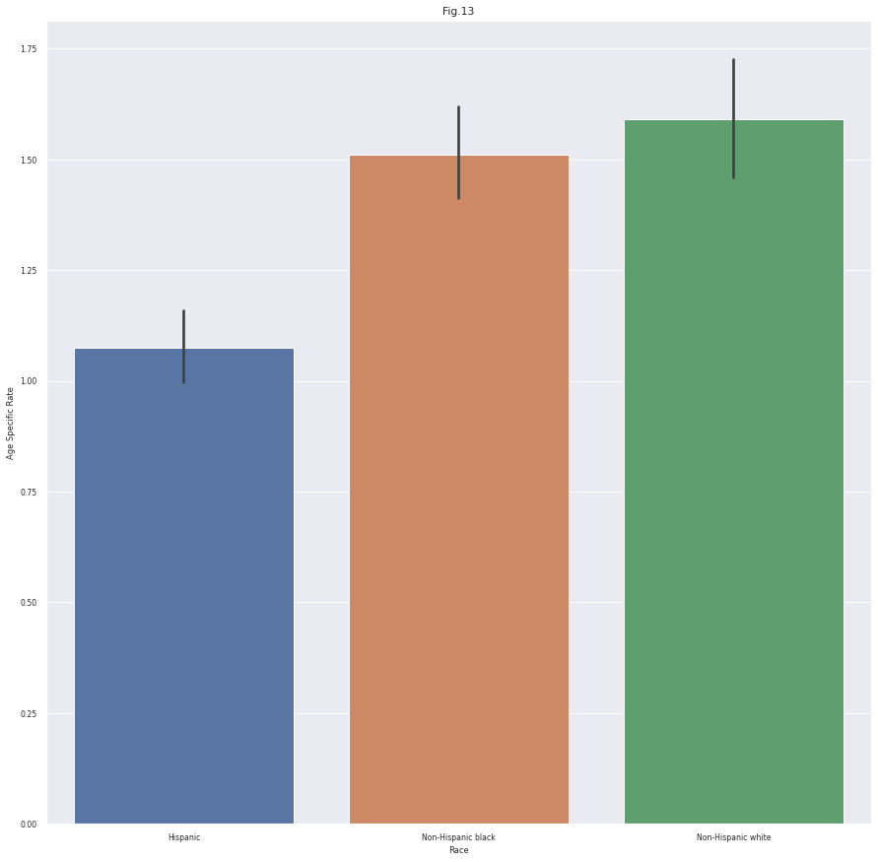
Age specific rate for each race

Slide 14
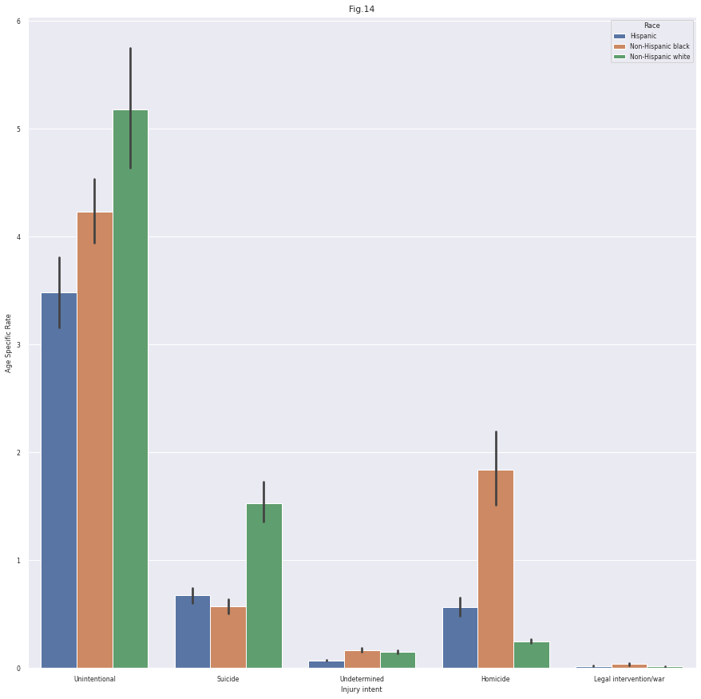
Age specific rate for each race with injury intent

Slide 15
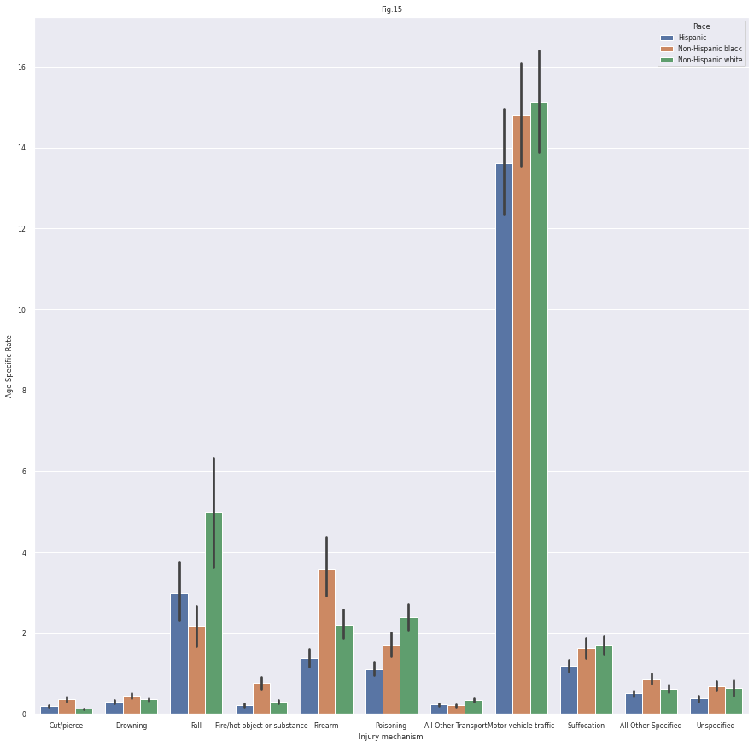
Death mechanism with race

Slide 16
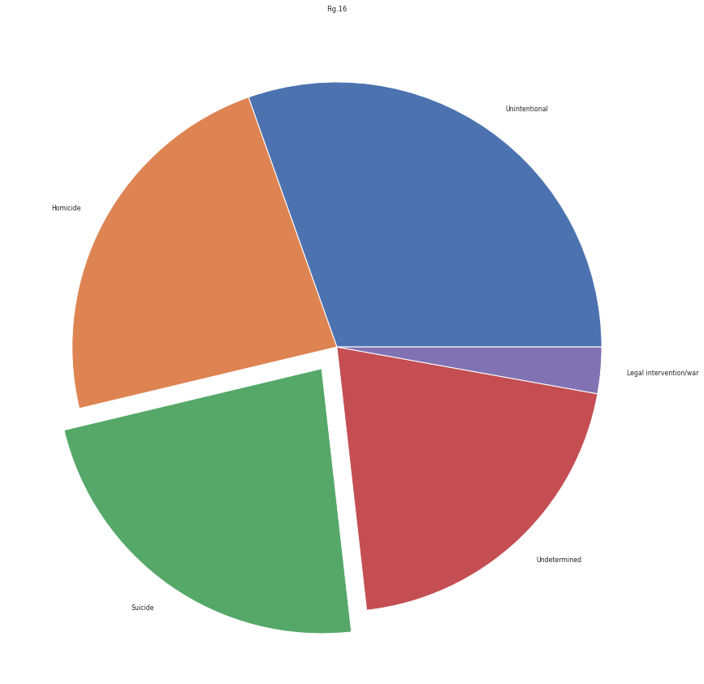
Death intent pie

Slide 17
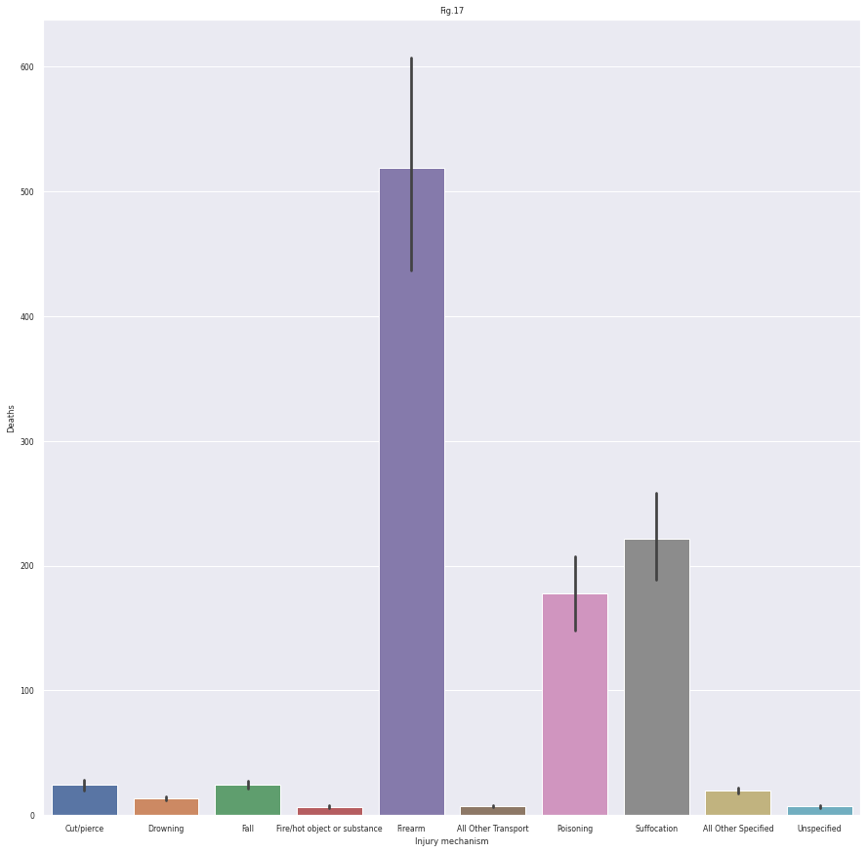
Suicide mechanisms

Slide 18
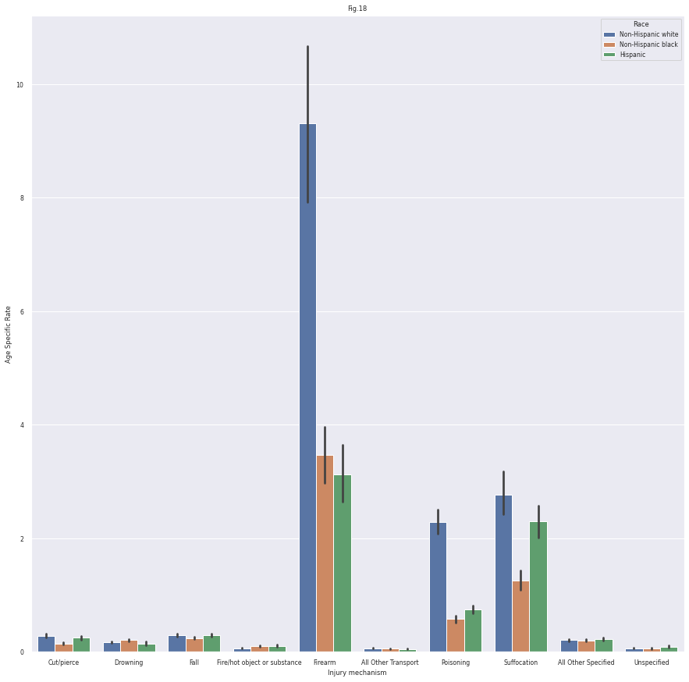
Suicide mechanism for each race

Slide 19
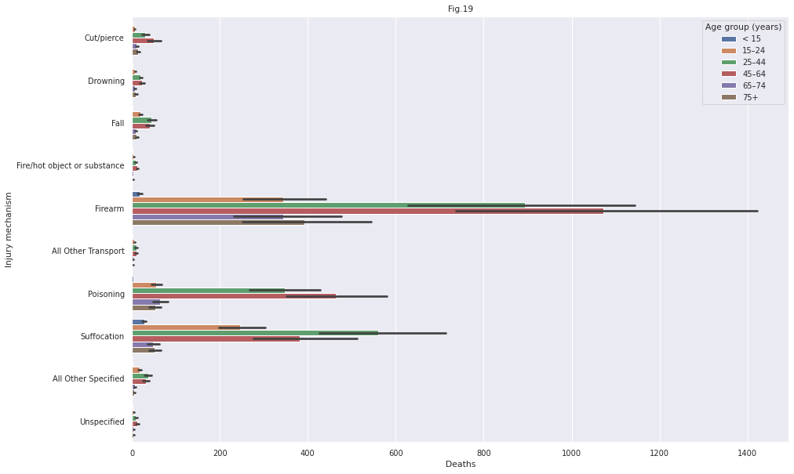
Suicide mechanism for age groups

Slide 20
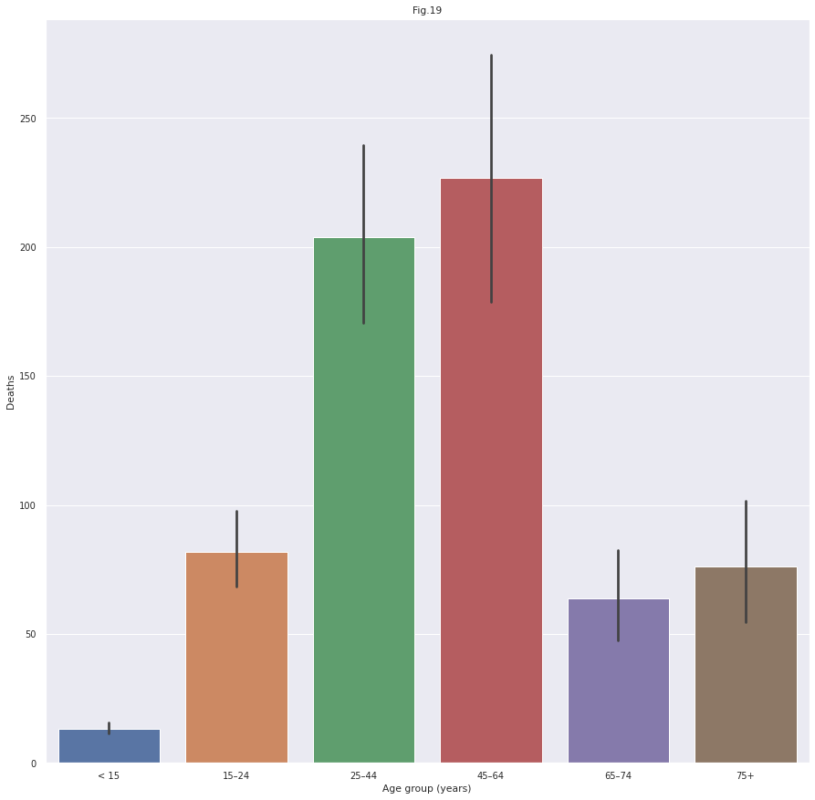
Suicide age groups

Slide 21
1- Males are more death expected than Females.
2- The most resident Age Specific Rate are with the age of more than 75 years then, the age range 25 to 44 then the range 15 to 24.
3- The most numbers of homicide victims are from Non-hispanic Black race. While the Non-hispanic white races are having the largest number of suicide deaths.
4- The total death rate is directly correlated with years. There was a decreasing in curve pattern nearly between the years of 2007 and 2009 which perhaps because of the update of population censuses used in 2010. (Read the description in kaggel website).
5- Suicide victims are more than homicidal victims and the unintentional victims have the largest number of deaths.
6- Most deaths are because of transport or traffic accidents.
7- The most ways used for suicide are Firearm, Suffocation and poisoning.
8- The most suicide victims are in the 45 to 64 years old group then the 25 to 44 years old group.

